Slide 1


Spark Interview Questions Spark Internals

Slide 2
What is Spark
Apache spark – is open source distributed big data processing engine.
It can process both streaming(real time) as well as batch data.
It provides Api(s) for cluster/distributive processing with implicit
Parallelism
Fault Tolerance
Spark provides high-level APIs in Java, Scala, Python and R, Spark code can be written in any of these four languages.
Spark works on the concept of the in-memory computation, which makes it around 100 times faster than Hadoop Mapreduce.

Slide 3
Spark Components
SPARK SQL
SPARK STREAMING
MLIB
GRAPHX
SPARK CORE
Standalone
Apache Mesos
Haddop YARN

Slide 4
Spark Cluster Manager
The system currently supports three cluster managers:
Standalone – a simple cluster manager included with Spark that makes it easy to set up a cluster.
Apache Mesos – a general cluster manager that can also run Hadoop MapReduce and service applications.
Hadoop YARN – the resource manager in Hadoop 2.,Stands for Yet Another Resource Negotiator.

Slide 5
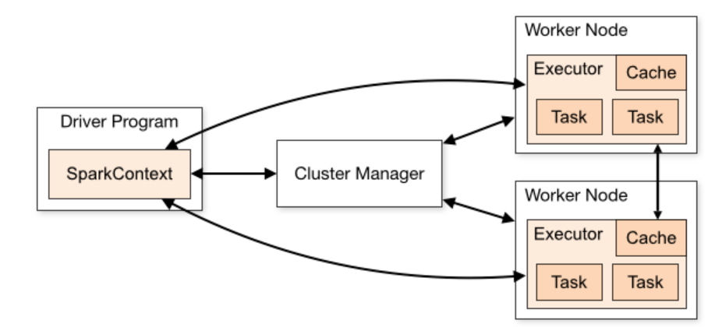
Spark Architecture

Slide 6
Spark Architecture Run-time Components
Spark Driver
The main() method of the program runs in the driver.
Driver creates SparkContext/SparkSession.
The driver is the process that runs the user code that creates RDDs/DataFrames/DataSets.
Driver performs transformations and actions.
The two main key roles of drivers are:
Converting user program into the task.
Scheduling task on the executor.

Slide 7
Spark Architecture Components
Spark Cluster Manager
Spark relies on cluster manager to launch executors.
Resources are allocated by Cluster manager for execution of tasks.
Cluster manager is a pluggable component in Spark.
Cluster manager can dynamically adjust resources used by a Spark application ,based on the workload.

Slide 8
Spark Architecture Components
Spark Executors
The individual task in the given Spark job runs in the Spark executors.
Executors launch once in the beginning of Spark Application and then they run for the entire lifetime of an application.
There are two main roles of the executors:
Runs the task that makes up the application and returns the result to the driver.
Provide in-memory storage for RDDs that are cached by the user.

Slide 9
Further Deep dive in the Part-2

Slide 10
Thanks and do subscribe to my channel

